Slide 1
System Development(COMP 1713 Data Analysis
Dr. Chaoying Ma, Dr. Simon Scola, EurIng. Alexander M. Fedorec

Slide 2
Review of Previous Lecture
To address problems of systems building we need to:
Break the development process into a set of manageable steps:
Requirements analysis and documentation
System Design
Implementation and testing
Deployment and maintenance
Decompose the system product into manageable components:
Based on functionality, information, deployment etc.

Slide 3
A Reminder - Requirements Engineering
Aim to produce a Requirements Specification that can be agreed with the client and can provide the basis for a Design Specification
Requirements Elicitation (from the client)
Understand the existing situation (the baseline as-is system)
Determine what a client needs (interviews, observation, current docs etc.
Identifying/capture requirements
Requirements Analysis
Determine what is needed to meet the client’s needs
Requirements Specification (to the developer/tester/maintainer)
Document requirements for the new system (the target to-be system)
The project background and overview problem statement
Project constraints and assumptions
The functional requirements (prioritised?)
Non-functional requirements
Appendices (glossary, source docs etc.)
Describe functional using an appropriate language/notation, e.g. UML, ERD
Notes:
3

Slide 4
Abstraction and Decomposition of the System Building Process
Good systems are ones which meet the customer’s stated or implied needs and requirements
Delivered System
Gather, Analyse and Document the requirements
Check what we have built meets the customer’s requirements
From the specified requirements produce a design
Test the implementation and verify it does meet the design
Implement System

Slide 5
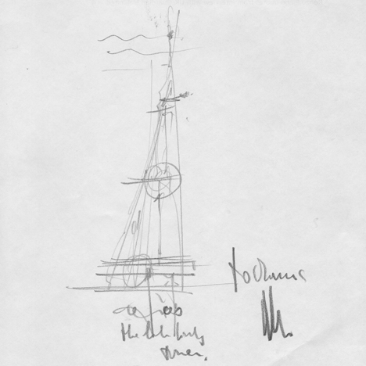
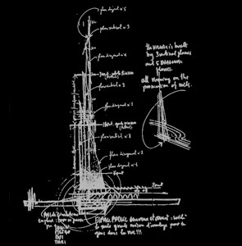
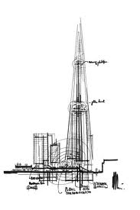

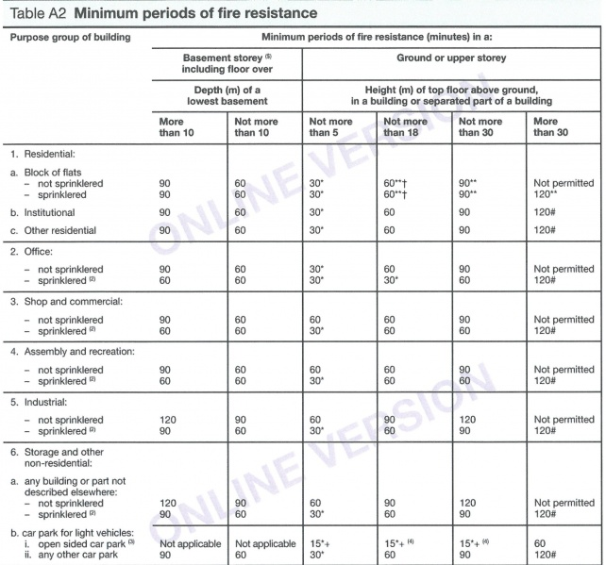
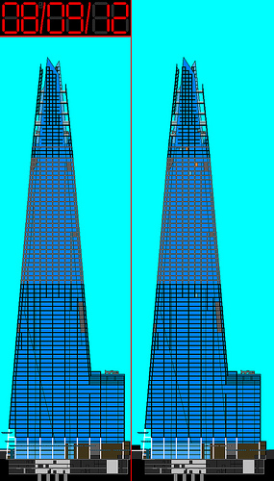

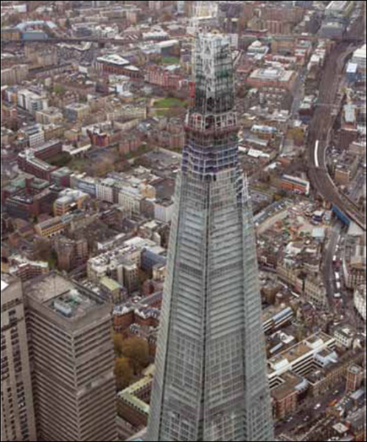
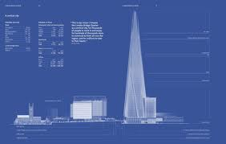
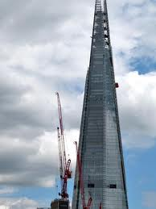
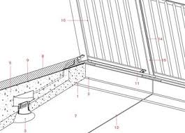
The Shard, Renzo Piano
Example Requirement Specification
Design
Active fire protection – i.e. sprinklers plus structural elements meeting required stability and stress criteria i.e. concrete-filled fabricated box sections made from 100 to 12 mm-thick plate plus a layer of intumescent coating
Delivered Product
Implementation
Specifies how the system will meet the requirement
(e.g. use sprinklers)
Specifies what the system is required to do (e.g. be 60 minutes fire resistant) Not how the system does it.
Verifying the Design
An assessment of fire loading, ventilation and likely temperatures were made and applied to a computer model of the structure
Ruby Kitching, The Shard, London - Steel strategies in case of fire, Construction News. 29/11/2012 <http://www.steelconstruction.info/The_Shard,_London>

Slide 6
This Week – From Requirements to Design Data Analysis
The importance of separating data management from applications
Identifying the conceptual entities from the requirements gathering
Identifying the relationships between them
Documenting these in an Entity-Relationship Diagram (ERD) for requirements and design specification.

Slide 7
Information in a System
Systems process information
Information is passed from one (sub)system to another as inputs and outputs
This information is in the form of
messages (“Right button clicked”, “set progress bar to 38%”) and
data (temperature: 37, slider position: 94)
Systems hold information:
sometimes temporarily just while they are doing something This is thrown away when the system has finished processing (‘Transitory data’ e.g. the running total when adding up a list)
sometimes permanently in data stores This is kept even when the system isn’t running (‘Persistent data’ e.g. an address book)
A system’s behaviour (outputs) will depend on what information it gets (inputs) and what information it already has (stored data) e.g how a bank will respond will depend on how much money you ask for and how much is in your bank account.
SYSTEM BOUNDARY
Inputs
SYSTEM
SUBSYSTEMS
Outputs
SYSTEM ENVIRONMENT
Notes:
S.E.1
23/02/2016
A.M.Fedorec
7

Slide 8
Data vs. Information
Data is a representation of a fact, figure, and idea…
Data are numbers, words, symbols, images, etc.
e.g. 43, 1.84, X 19, 1.82, M 25, 1.78, S 24, 1.85, XL
Data must be interpreted by a human or machine to derive meaning
"Information is interpreted data" i.e. meaningful
Information is data + metadata (‘data about data’)
e.g. Age (yrs), height(m), size
43, 1.84, X 19, 1.82, M 25, 1.78, S 24, 1.85, XL
MetaData
Data
Note: The terms Data and Information are often used interchangeably
We used to talk about ‘data processing systems’ nowadays we tend to refer to ‘information systems’

Slide 9
Data in Systems
What information is stored in your mobile phone?
e.g. Address book, text messages received
How is it used?
e.g. Search for friends number, list all texts from friend, remember friends birthday, find out when and where the party is…
What inputs and outputs are there?
e.g. Type in name and click ‘search’, select and scroll through SMS message, display location on map…
What information is stored in a ‘shoot-em-up’ game?
How is it Used? What inputs and outputs are there?

Slide 10
Data Analysis
The same information may be used by many different processes and applications in a system
Example: A college information system needs facilities to
Register students on programmes.
Attach students to course options and allocate them to tutorial groups
Assign lecturers and tutors to the courses and tutorials
Produce class lists and registers
What information does the system need to hold?
Student name and address, registration id number, programme name year and stage, list of valid options for each programme, course option names and tutorial groups for each course, lecturer details, register date and so on?????
At a system’s level we need to know what data is being used, who is using it and what do they do with it.

Slide 11
Example Data for a College System
First Name | Surname | Reg. Id | Programme | Course 1 | Lecturer 1 | Course 2 | Lecturer 2 | Course 3 | Lecturer 3 | Tutorial | Tutor
Akhil | Ahmed | 512057 | Computing | SysBld | A.Fedorec | CSN | P.Smith | AMC | C.Ma | C1 | B.Dolden
Ahmet | Francis | 512132 | Bus IS | CompSys | B.Smith | SysBld | A.Fedorec | CSN | P.Smith | CS2 | L.Bacon
Emma | Dinesh | 512096 | Business IS | CompSys | P.Smith | CSN | P.Smith | AMC | C.Ma | CS3 | P.Smith
Mahiban | Ahmed | 512069 | Elec Eng | CSN | B.Smith | CmpSys | P.Smith | AMC | C.Ma | C2 | L.Bacon
Dean | Omar | 512123 | Elec Eng | CSN | Pete Smith | SysBld | A.Fedorec | CSA | S.Scola | CS3 | P.Smith
Kobir | Kayum | 512156 | Computer Sci | SysBld | A.Fedorec | AMC | C.Ma |  |  | CS2 | L.Bacon
Ryan | Duff | 512174 | Compter Sci | SysBld | A Fedorec | CSN | P.Smith | AMC | C.Ma | T1 | B.Dolden
Omar | Desai | 512168 | Sw Eng | SysBld | A.Fedorec | CSA | S.Scola |  |  | CS3 | P.Smith
Joshua | Smith | 512081 | Networking | CSN | P.Smith | AMC | C.Ma | CSA | S.Scola | T1 | B.Dolden
Dean | Omar | 512138 | Sw Eng | SysBld | A.Fedorec | CompSys | P.Smith | CSN | P.Smith
Flora | Onyeulo | 512129 | Computing | SysBld | A.Fedorec | AMC | C.Ma | CSA | S.Scola | CS3 | P.Smith
Daniel | Mwangi | 512099 | Networking | CSN | P.Smith |  |  |  |  | CS3 | P.Smith
James | Patel | 512147 | Business IS | CompSys | P.Smith | AMC | C.Ma | CSA | S.Scola | CS3 | P.Smith
Ashish | Moyez | 512072 | Comp Sci | SysBld | A.Fedorec | CompSys | P.Smith | CSN | P.Smith | CS2 | L.Bakon
Kyle | Smith | 512090 | Comp Science | SysBld | A.Fedorec | AMC | C.Ma | CSA | S.Scola | CS2 | L.Bacon
Sam | Dzimwasha | 512177 | Computing | SysBld | A.Fedorec | CSA | S.Scola |  |  | CS2 | L.Bacon
Maximilian | Moyez | 512159 | Computing | SysBld | A.Fedorec | AMC | C.Ma |  |  | CS2 | L.Bacon
Alan | Gill | 512078 | Bus. IS | CompSys | P.Smith | SysBld | A.Fedorec | CSN | P.Smith | CS2 | L.Bacon
Michael | Soysald | 512102 | Sw Eng | SysBld | A.Fedorec | CSN | P.Smith | AMC | C.Ma | CS2 | L.Bacon
Warnakula | Mwangi | 512189 | Comp Sci | SysBld | A.Fedorec | CSN | P.Smith | AMC | C.Ma
Imagine there are thousands of students, tens of programmes and hundreds of courses, what problems can you identify with organising, managing and using this data?
What if we want to add further applications to our system to record marks for each assessment or attendance at each tutorial?
How do we manage complexity?
Abstraction and decomposition!

Slide 12
Why Data Analysis and Modelling? - Example
A college system needs facilities to:
Register students on programmes and maintain their contact details.
Attach students to course options and allocate them to tutorial groups
Produce class lists and registers for the lecturers
Assign lecturers and tutors to the courses and tutorials and produce facilities for the students and lecturers to check their timetables
Provide a means for lecturers to record students course grades and publishing them for the exam boards
What information does the system need to hold?
Student name and address, registration id number, programme name year and stage, list of valid options for each programme, course option names and tutorial groups for each course, lecturer details, register date and so on….
What are the problems if each application maintains it’s own data files?
What happens when a student gets married and changes their name or changes one of their course options?
Do you need to go into each application, find the student or course information and change it?
Maintain and Print register
Grades data entry statistics and printing
import
export
24/10/2013 14:03
SysBld.12

Slide 13
Why Data Analysis and Modelling Cont’d Separating Data from Applications at a Systems Level
Each application decides how the data is captured, processed and presented.
Enter grades and view statistics
Stores common set of data
Lecturer
Teaching support Applications
Data management system
Data store
Student registration and records
Provides a common set of operations to create, read, update and delete data
Hides details of how data is actually stored
Student records programs
Administrator
Notes:
Define common set of data, develop common set of operations for manipulating data (open/close/search(seek) files)
Each application is to decide how the data is captured, presented, etc.
13

Slide 14
Data Modelling Objectives
Capture all the data that the system needs to store and organise the data in an efficient way:
Identification of the data objects (“entities”) in the system, their structure, and the relationships between the entities
Independent of the specific processing requirements
Robust, i.e. minimal model of the data required to be stored by the system
Logical, i.e. model is not concerned with how the data storage will be, or is currently, physically implemented.
Two techniques for data modelling:
Entity-Relationship Modelling (top-down) – more this week
Britton & Doake, Software System Development 4e, McGraw-Hill, 2006

Slide 15
Entity-Relationship Modelling
In order to design a good information system we need to:
Decompose – break down the system in components (entities)
Abstract – Produce a ‘conceptual model’ i.e. a high level view (ignoring the detail) of what the components (conceptual entities) of the system are and the relationships between them
Compare with a buildings architect – would you put in the detail of each screw or pipe in your initial plans?
We do this with ER Modelling (later in the course we will extend this to ‘Object Modelling’)

Slide 16
Abstraction
ABSTRACT
(concept)
A student
An undergraduate student
A student reading BSc Computing at Greenwich
A first year student on the 2013 cohort reading Computing at Greenwich
Adam Smith, born 13th January 1992, a first year student on the 2013 cohort reading BSc Computing at Greenwich and taking the Programming and System Building courses.
Adam Smith, born 13th January 1992, a first year student on the 2013 cohort reading BSc Computing at Greenwich in tutorial group 3, taking the Programming and System Building courses as he was at the end of the first term (as contrasted with how he was a few weeks later when he received a mark of 65% for his programming and 70% for System Building).
CONCRETE
(instance)

Slide 17
Objectives of ER Modelling
To identify the entities of a system
their structure
the relationships between them
To construct a model which is independent of specific processing requirements
To construct a robust data model, i.e. a minimal model (little redundancy)
To construct a logical model of the data
Not how the data will be stored currently and/or physically
Notes:
17

Slide 18
Entity-Relationship Modelling
Identify the conceptual entities (things) in the system
* Identify the attributes of the entities
Identify the relationships between them
* Identify the roles and cardinalities of the relationships
Example:
Students are registered on a programme which consists of a number of courses each of which has one or more lecturers teaching it. The student can take up to four courses at a time. A lecturer may teach several courses.
* More on attributes and cardinality later

Slide 19
Entities
An entity is a thing which is recognized as being capable of an independent existence and which can be uniquely identified
An entity may be: a physical object (e.g. a student) an event (e.g. a lecture) or a concept (e.g. a degree)
Entities can be thought of as nouns
Example:
Students are registered on a programme which are made up of a number of courses each of which has one or more lecturers teaching it. The student can take up to four courses at a time. A lecturer may teach several courses.
See http://en.wikipedia.org/wiki/Entity-relationship_model

Slide 20
Entities vs. Occurrences
Entities are a Type or Class of thing
Example Entities
Lecturer
Course
Programme
Occurrences are single instances of an entity
Example Occurrences (Instances)
Alex Fedorec
Chaoying Ma
Simon Scola
System Building
Programming
Communication Systems
BSc Computing
BSc Business Information Systems
BSc Games Technology
Later we will talk about objects being instantiations of classes
Notes:
Printer: when you search to connect to a network printer (colour printer? Speed? Document format supported, …)
Alarm went off (when, where, why, …)
Team (leader, member, size, when created/dissolved, …)
20

Slide 21
Exercise
Pirates of the Caribbean, Sherlock Holmes and Blade Runner
Are these entities or instances?
If they are instances what entity type are they?
What entities might you identify in a library system?
Give three example instances of a book entity
Notes:
When concerning a type of things – entity
When consider an individual, e.g. which one of a group of things (identifiable … when you put in values of the attributes: name=Chaoying,… )
21

Slide 22
Relationships
A relationship captures how two or more entities are related to one another.
A relationship is a link between two entities, which is significant for the system,
Relationships can be thought of as verbs, linking two or more nouns.
Example:
Students are registered on a programme which consists of a number of courses each of which has one or more lecturers teaching it. The student can take up to four courses at a time. A lecturer may teach several courses.
Is there a relationship between students and lecturers? What?
Is it significant for the system? Where is it stated in the briefing?

Slide 23
Entities and Relations
Students are registered on a programme which consists of a number of courses each of which has one or more lecturers teaching it. The student can take up to four courses at a time. A lecturer may teach several courses.
entity relationship entity
Student registered_on Programme
Programme consists_of Course
Lecturer teaches Course
Student takes Course

Slide 24
Entity-Relationship Diagram (ERD)
E-R Models are normally represented graphically
There are several notations (diagramming conventions).
In all an entity is represented by a box and a relation as an arc (line) between two entities
The most widely used notations are Chen, Crow’s Foot and UML. We will start with Crow’s foot.
Lecturer
Course
teaches

Slide 25
A Simple Entity-Relationship Diagram
Students are registered on a programme which consists of a number of courses each of which has one or more lecturers teaching it. The student can take up to four courses at a time. A lecturer may teach several courses.
entity relationship entity
Student registered_on Programme
Programme consists_of Course
Lecturer teaches Course
Student takes Course
entities
Student
registered_on
Programme
relations
takes
consists_of
Lecturer
teaches
Course

Slide 26
Reading the Relation
teaches
teaches
Course
Lecturer
Lecturer
Course
Because in English we read from left to right and you know about courses, you read this as ‘Lecturer teaches course’
But what if the Course entity was on the left side of your diagram?
Most notations (Chen, Bachman, IE etc.) put the verb next to the noun which is the subject then the relation is read subject-verb-object:
This can now be read as “Course is_taught_by Lecturer” and “Lecturer teaches Course”
Later we will be using UML notation which uses an arrow head to indicate the direction the relation should be read in. e.g.
Course
is_taught_by
teaches
Lecturer
Course
is_taught_by ►
Lecturer
◄ teaches

Slide 27
The Degree of Relationships (Cardinality or Multiplicity)
One of the things we need to express in our analysis is the ‘cardinality’ of a relation
This represents the number of occurrences objects in a given relationship
Student
registered_on
Programme
takes
consists_of
Lecturer
teaches
Course
We need to answer questions such as:
Can a student be registered on more than one programme?
Can they take more than one course?
Can a lecturer teach more than one course?
Is a course taught by more than one lecturer?
Notes:
27

Slide 28
Degree of Relationships – Crow’s Foot Notation
Relations between Instances
Entity-relationship diagram
One-to-one Crow’s Foot Notation
Husband Wife
Mr White Mrs White
Mr Javed Mrs Javed
One-to-many
Tutor Student
Md. Patel
Dr Scola Flora Smith
Bill Duff
George Green
Dr. Ma Will Blair
Asim Mwangi
Alice Band
Many-to-many
Course Student
Md. Patel
System Building Flora Smith
Bill Duff
Programming George Green
Will Blair
Computer Networking Asim Mwangi
Alice Band
Husband
marriage
Wife
Tutor
teaches
Student
Will hasn’t been assigned a tutor yet!
Course
Student
Notes:
28

Slide 29
ERD with relationship cardinality added
Students are registered on a programme which consists of a number of courses each of which has one lecturer teaching it. The student can take up to four courses at a time. A lecturer may teach several courses.
Student
registered_on
Programme
consists_of
takes
option_on
Lecturer
Course
teaches
Note Crows Foot Notation

Slide 30
Example Consider the following statement
The customers place requests with the XYZ Double Glazing Company. The request will be used to generate a number of (one or more) work orders. Each work order has a list of required materials (products) and comprises a number of tasks. The company maintains a standard table of work tasks, e.g. door/window installation, from which each task in the work order can be selected.

Slide 31
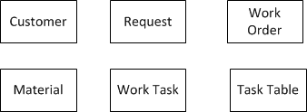
Example - Identify Candidate Entities
Customers place requests with the XYZ double glazing company. The request will be used to generate a number of (one or more) work orders. Each work order has a list of required materials (products) and comprises a number of tasks. The company maintains a standard table of work tasks, e.g. door/window installation, from which each task in the work order can be selected.
Notes:
31
Scan the doc many times and add/remove entities as appropriate.

Slide 32
Example Cont’d - Find Relationships
The customers place requests with the XYZ double glazing company. The request will be used to generate a number of (one or more) work orders. Each work order has a list of required materials (products) and comprises a number of tasks. The company maintains a standard table of work tasks, e.g. door/window installation, from which each task in the work order can be selected.

Slide 33
Entities and Attributes
An entity is generally a composite set of information
It has a set of attributes for example a student (entity) has (attributes) name, address, age, gender, etc.
More on attributes next…

Slide 34
Summary and Questions
Addressing Complexity – Decomposition and Abstraction
Break down process into smaller steps
Breakdown product into smaller parts
Analyse:
Functionality/Behaviour
Data/Information
ER Modelling for Data Analysis
Identify conceptual entities
Identify relationships between entities Cardinality of Relations (1-1, 1-M, M-M)
Graphical notations
Chen/ Crow’s foot notation

